Slide 1
Lecture 12
Neighborhoods and Human Development: The international situation
12.2 City shape, topology and incremental models of urban planning
© Luís M. A. Bettencourt 2023
IUS 3.3.8 + 6.2
Notes:
Here, we will be more analytical about city street networks, complementing the general models we introduced when studying urban scaling theory.

Slide 2

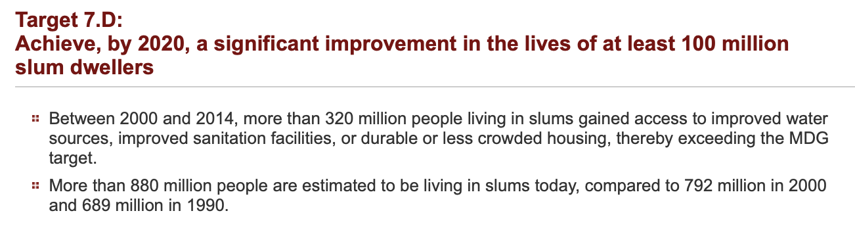
‘The absence of data from large areas of the world on slum indicators
substantiate the view that these precarious settlements are still
“zones of silence”
in terms of public knowledge, opinion and discussion about urban poverty’
Millennium Development Goals
—UN-Habitat 2003
Notes:
We started with the issue of informal settlements, We want to see them in the light of connectivity now.

Slide 3
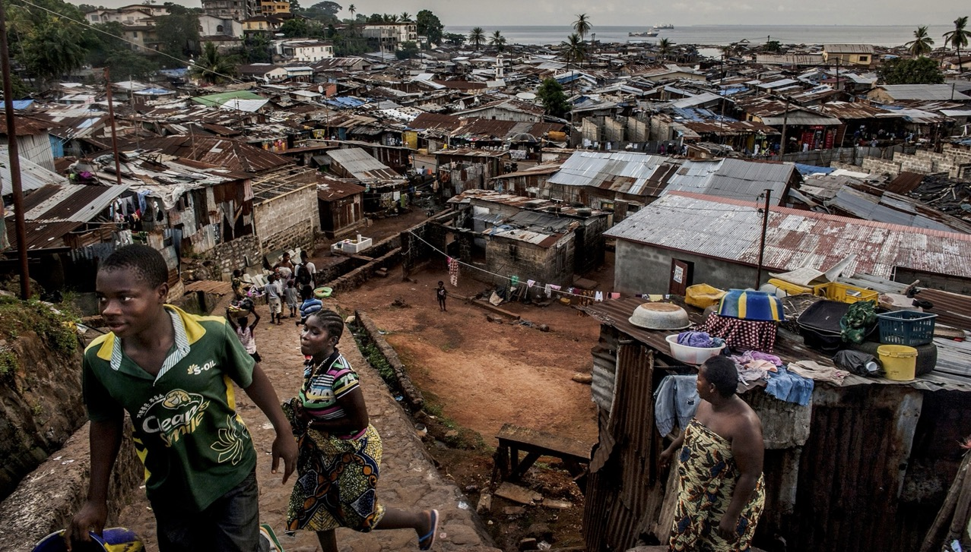
Kroo Bay, Freetown, Sierra Leone
credit: Pete Muller, National Geographic
Notes:
This is a neighborhood of Freetown, Sierra Leone, and we see some infrastructure but also clearly many deficits of services: how do we characterize these situations, where neighborhoods are settled before the networks (physical and perhaps socioeconomic) of the city are fully formed?

Slide 4
City shape, topology and change
Notes:
First, we are going to take a step back and ask what functions do street deliver and to where, so that we can start to better understand what they have to look like.

Slide 5
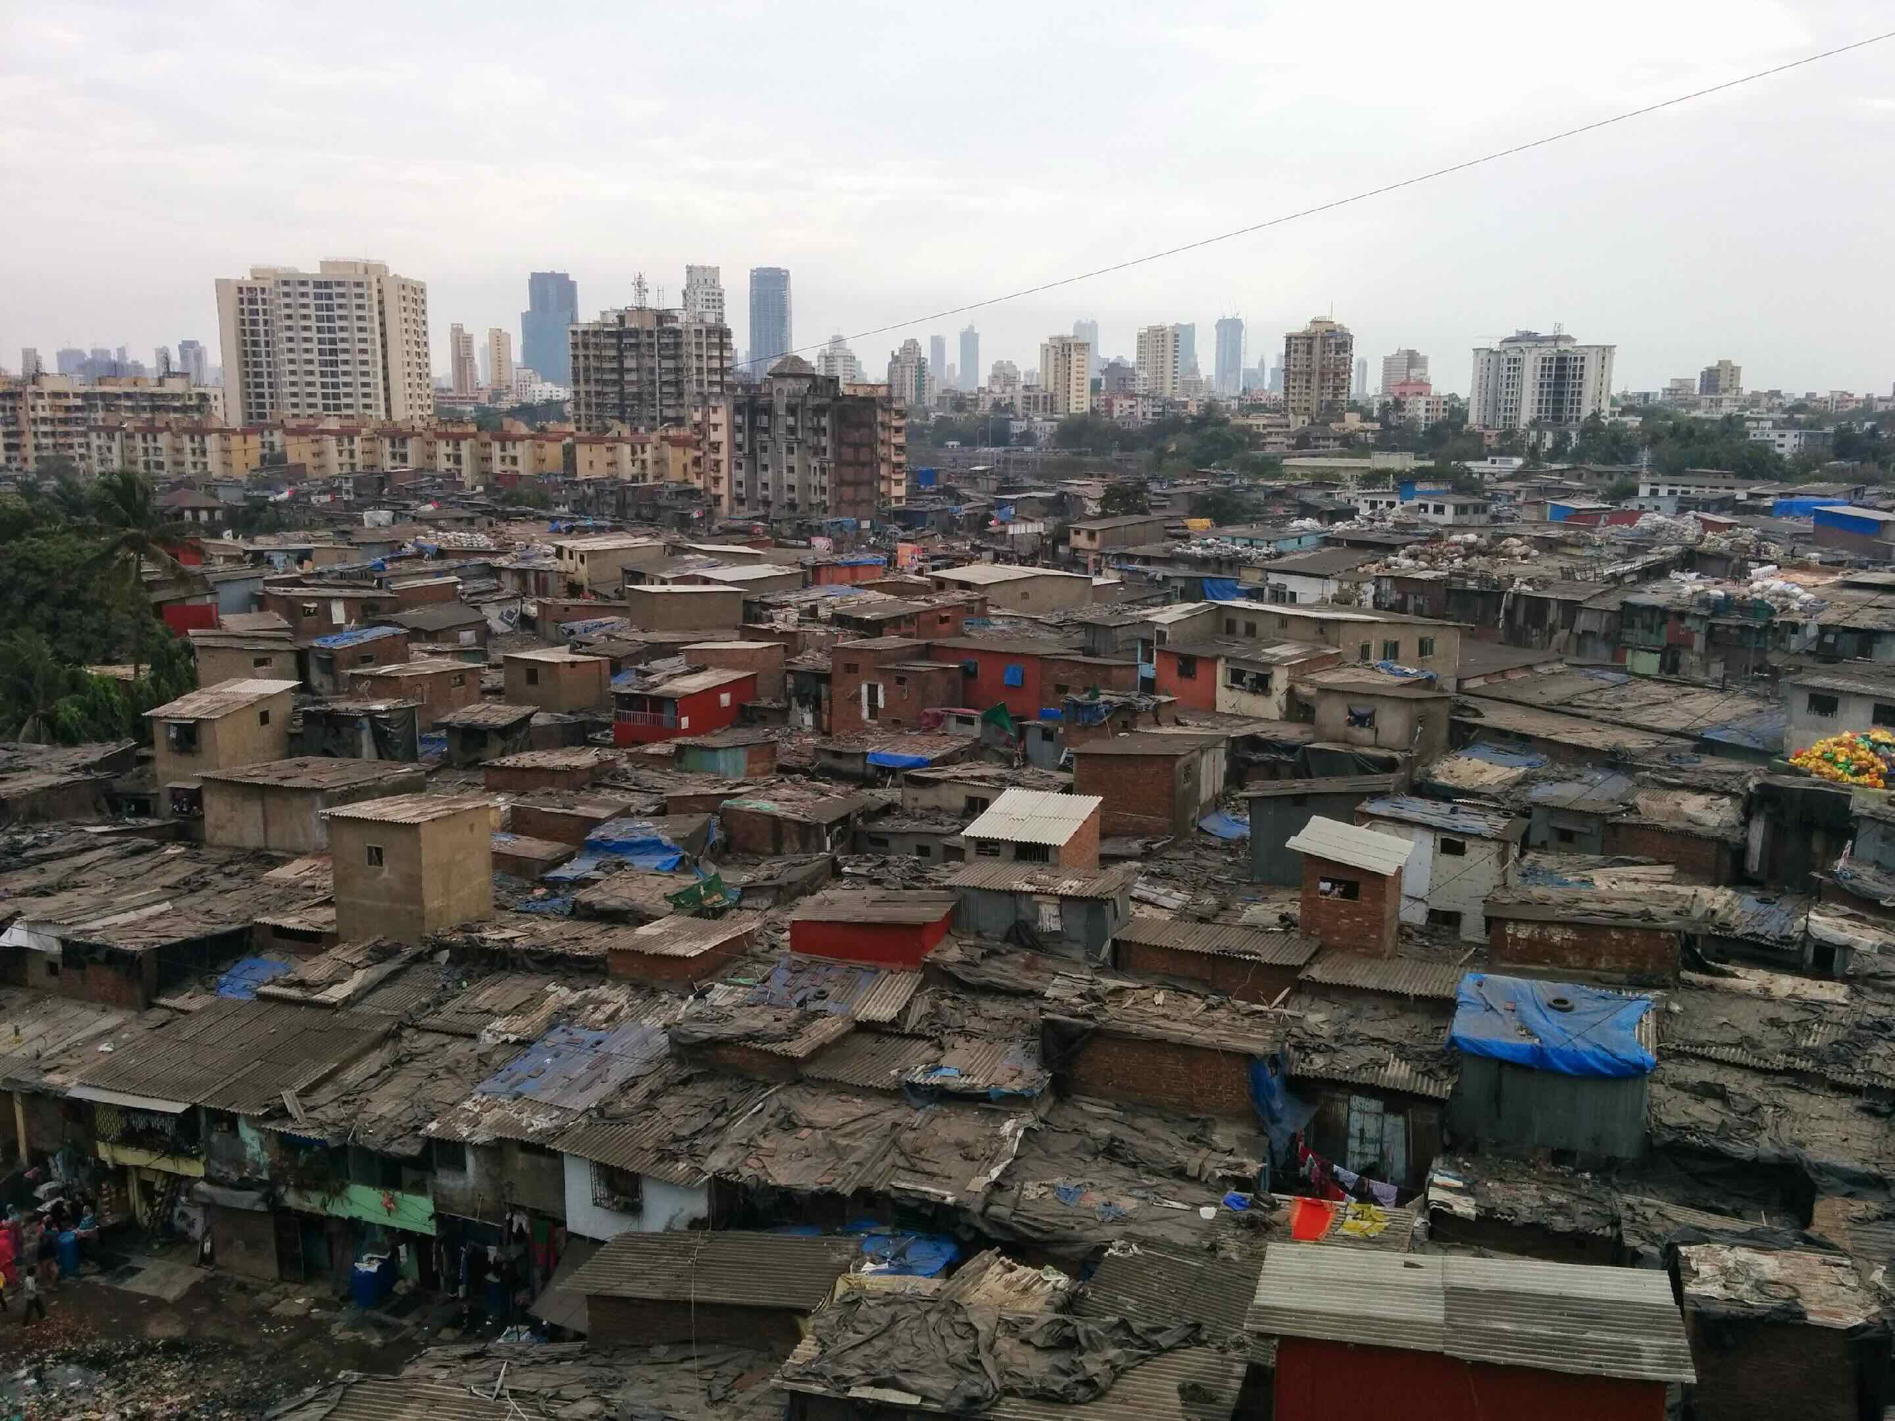
Is there an ideal city form?
Notes:
An old question in urban planning… (somewhat platonic) Our answer will be no, but that some functions need to be present: this will be a matter of topology (of relations between things) and not of geometry per se. Geometry is much more rigid (a street grid for example) and is not by itself functional.

Slide 6
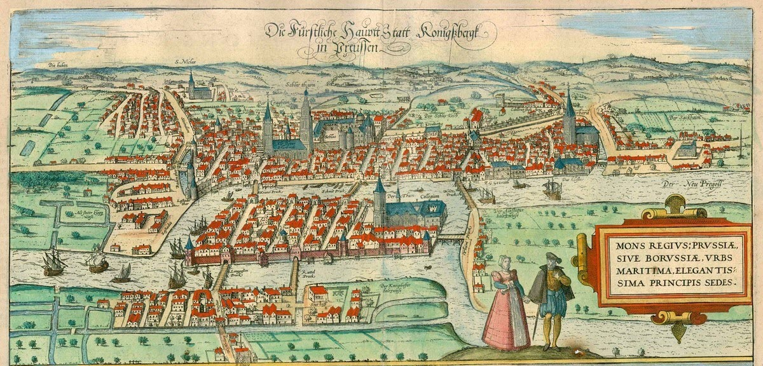
Königsberg, Prussia
Notes:
There is a nice story here: where cities, mathematics and geography all come together. This is the city of Konigsberg (Kaliningrad) that inspired its beginning.

Slide 7
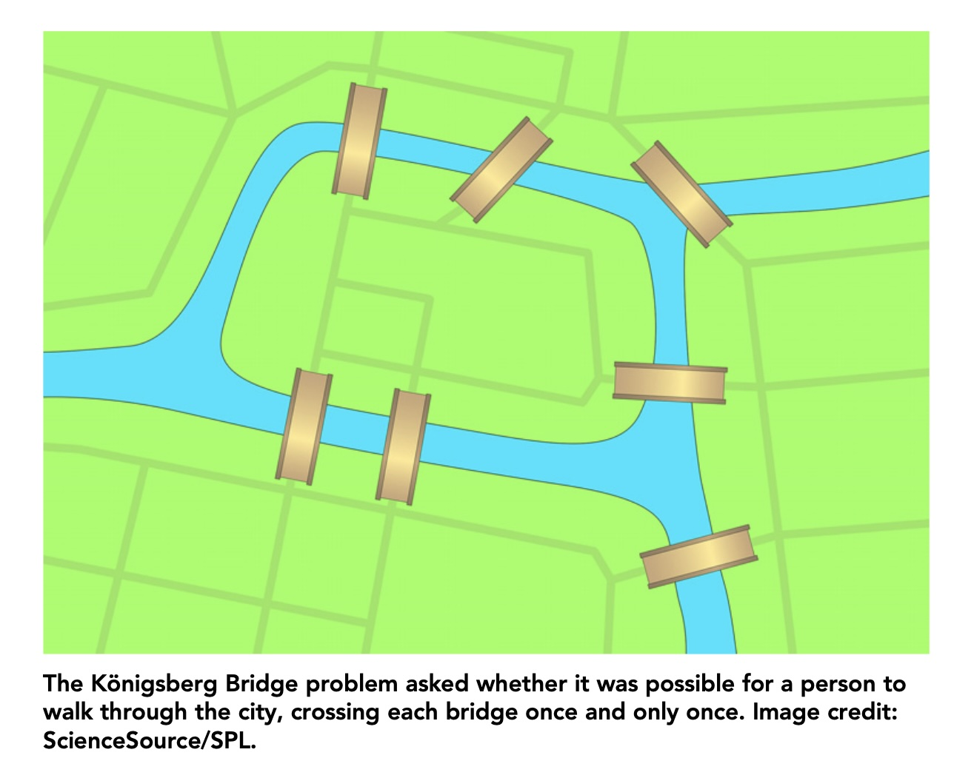
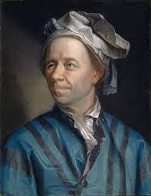
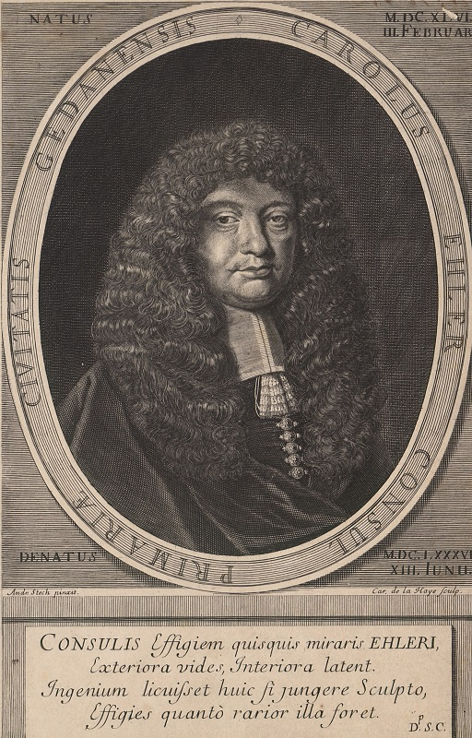
“This question is so banal, but seemed to me worthy of attention in that [neither] geometry,
nor algebra, nor even the art of counting was sufficient to solve it.”
???
Leonard Euler
“geometria situs” —> topology
Kart Gottlieb Ehler
https://www.pnas.org/doi/10.1073/pnas.1904847116
Notes:
Good problems are very transparent, easy to state: there was apparently a problem in Konigsberg (and a game) of whether one could go for a stroll crossing each bridge only once. Ehler (a mathematician and a mayor) was stumped and decided to ask someone who might figure out, no less than Leonard Euler. You can see his answer above, he was initially stumped too, but then invented a whole new field of mathematics called topology (he called it initially “geometria situs”). As the word meaning betrays this is about the knowledge of place. What is this knowledge?

Slide 8
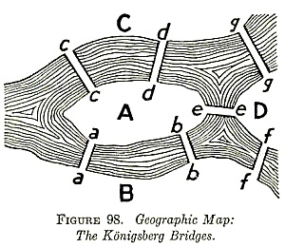
number of bridges must be even, expect at starting and finishing points
https://mathworld.wolfram.com/KoenigsbergBridgeProblem.html
Geometry —> Topology —> Graph Theory
degree
3
5
3
3
All odd degre: Eulerian circuit is not possible !
Notes:
What Euler (and what good minds do) is to not take the problem too literally, and see instead the general structure under it. The structure is about places and relations ships (here the bridges), in the process he invented graphs (or networks), which express such relationships in abstract (non-geometric) form, then you can reason: You can see it above, to provide transit (only once) each place has to have an even number of bridges except 2: the beginning and end. If you look at each place and its links, they all have odd links and so it cannot be done. There is no walk that solves the problem, crossing each bridge only once.

Slide 9
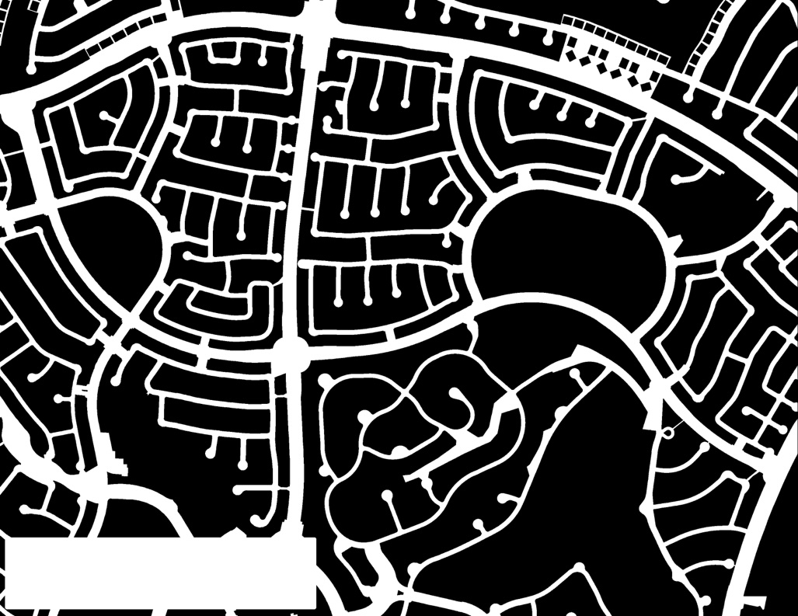
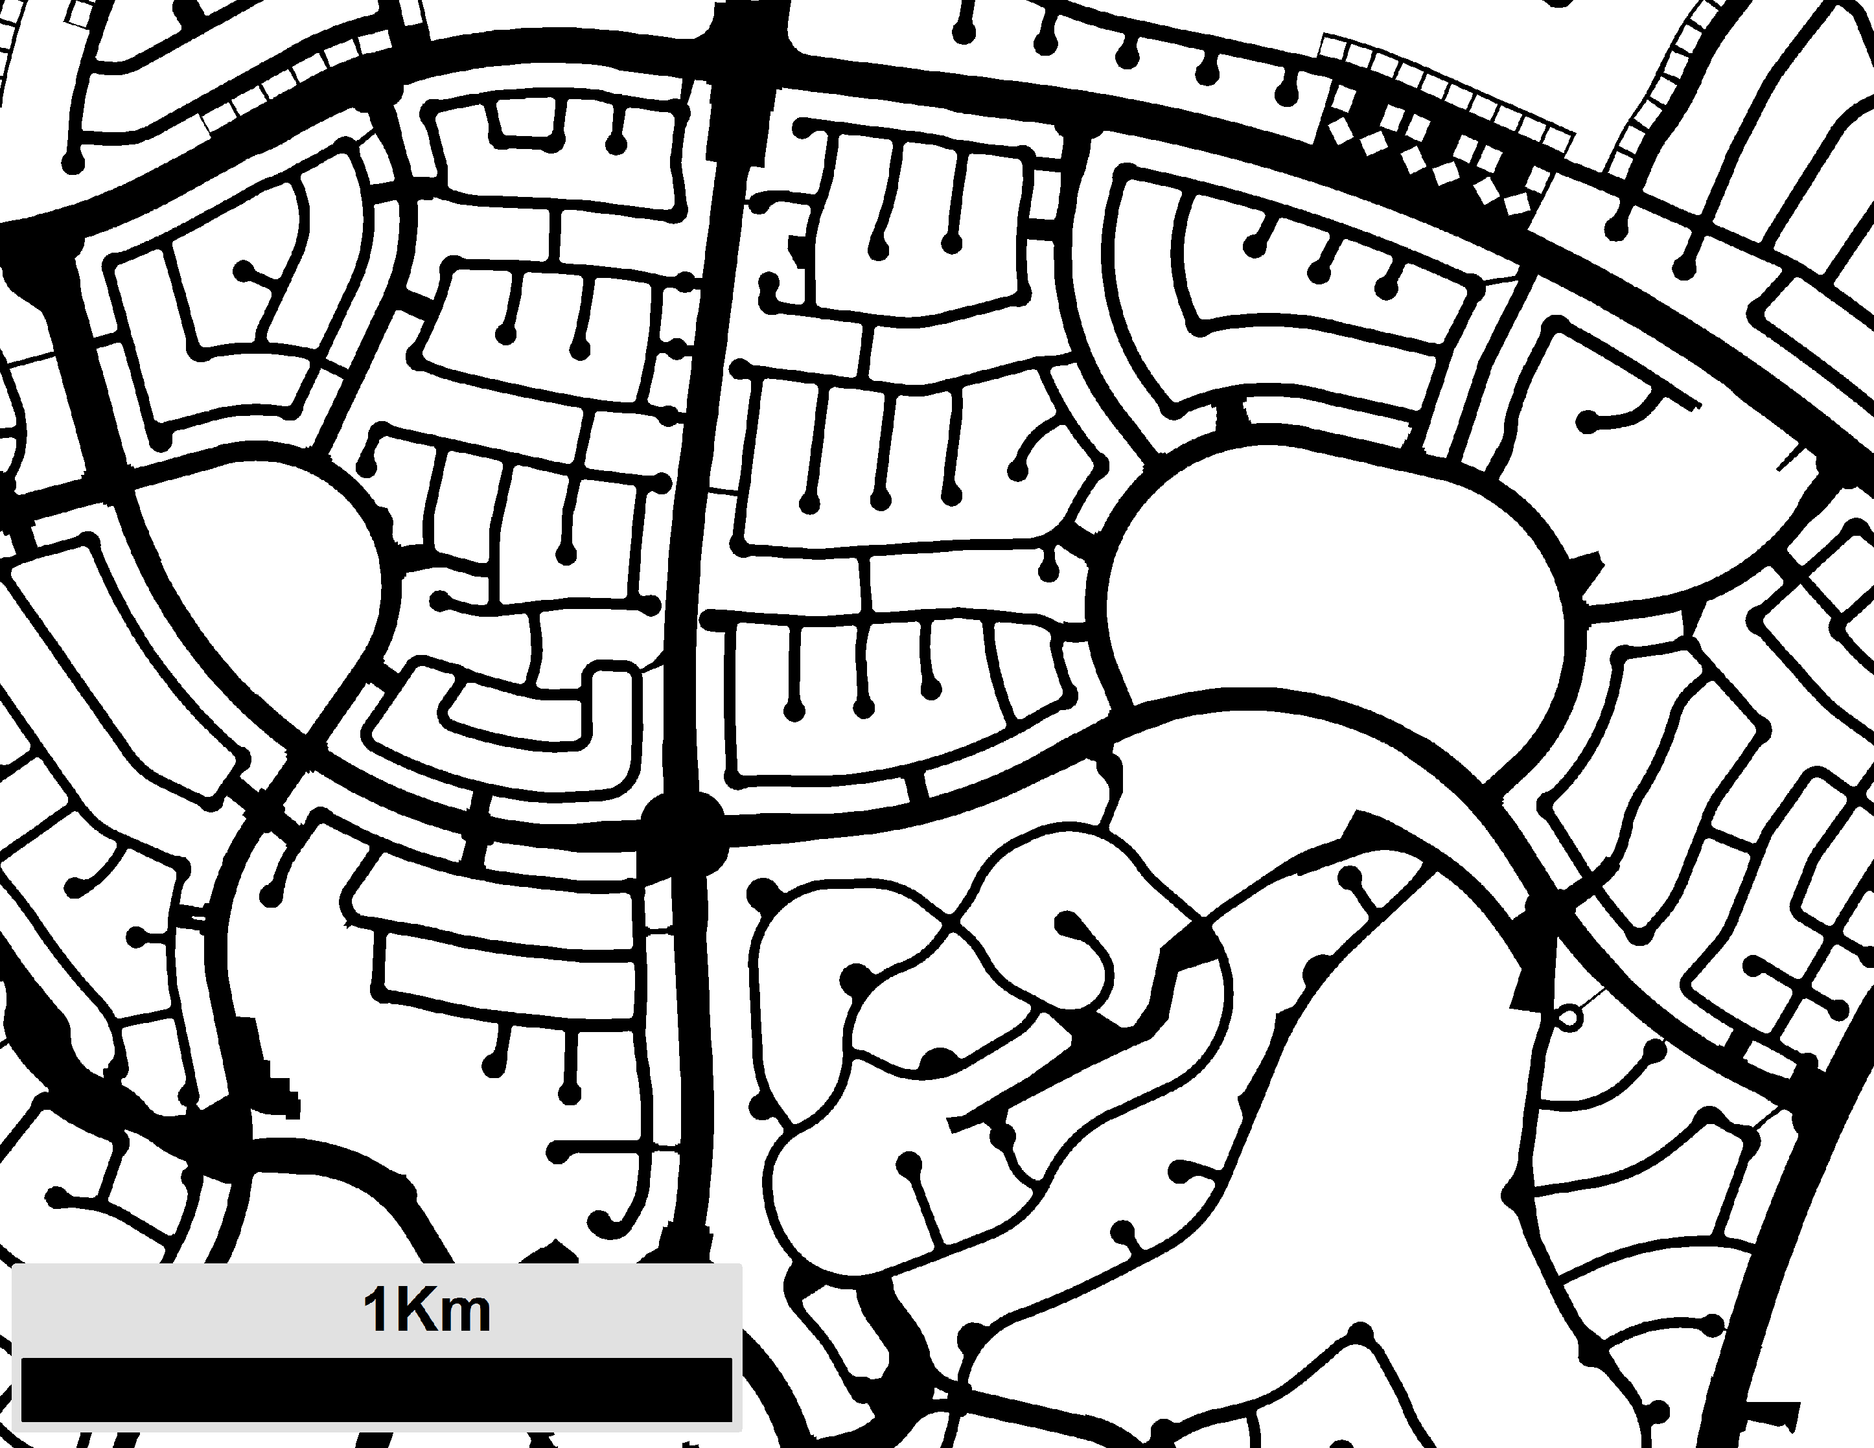
Notes:
What then, is the class of shapes that gives us this (suburb subdivision of Las Vegas, NV)? And is this the same class for all cities ?

Slide 10

Notes:
Note that these are roads, which are relationships (“bridges”) between places, but that this is much more complicated than the Konigsberg problem…

Slide 11
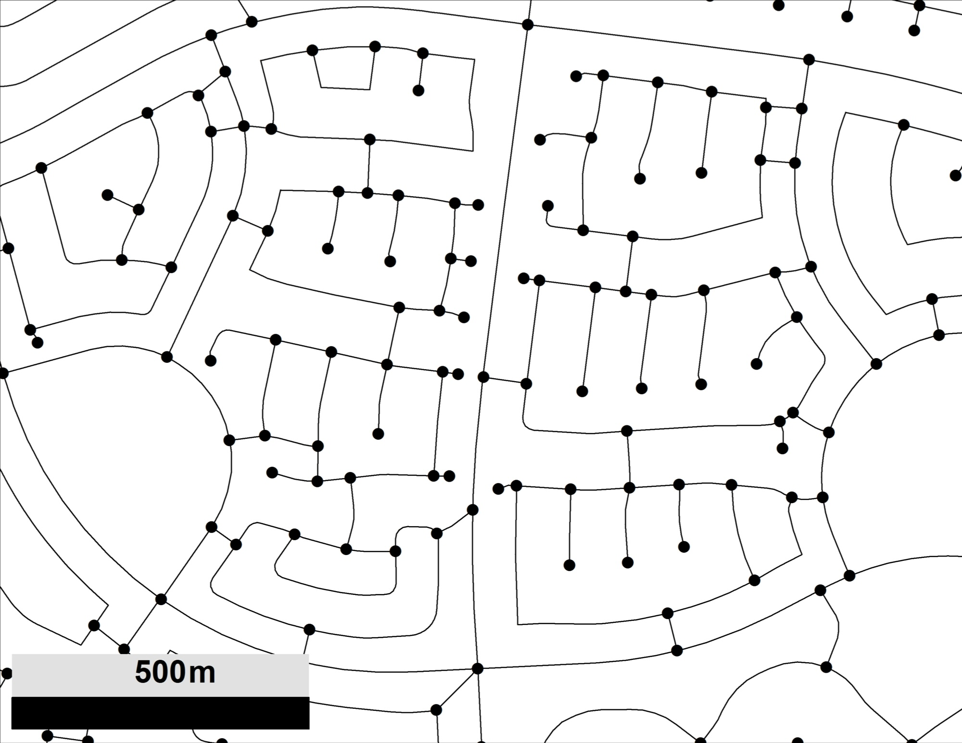
Notes:
It can nevertheless be represented as a graph, like Euler did. The expectation then is that this abstract graph contains the topology (the relationships, but not the physical details) of cities.

Slide 12
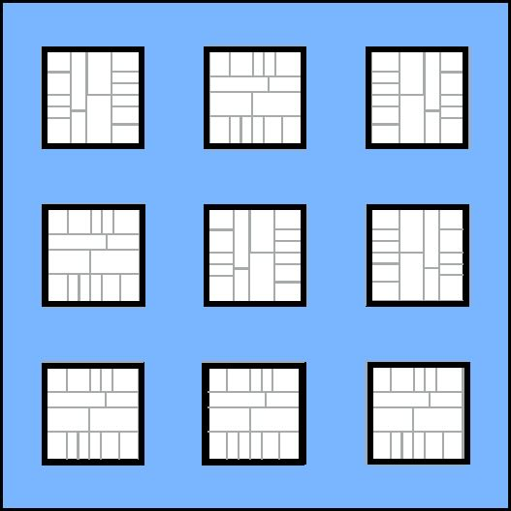
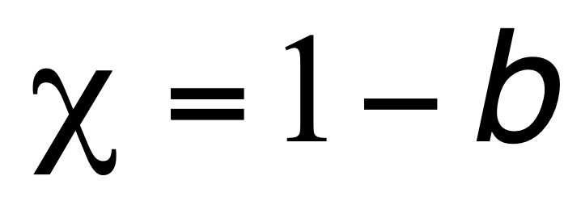
Notes:
Because we can deform the geometry, we can start focusing on a simple form for the city. Inspired by a bit of observation, we can think of a city as a set of blocks (places, where buildings are but also parks, etc), surrounded by streets (here in blue). This shape is a plane (or disk) with a number of b holes in it, each corresponding to a street block. This shape has an Euler characteristic - an index characterizing shapes - of 1-b.

Slide 13
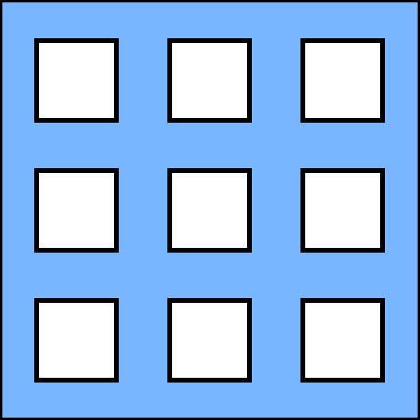
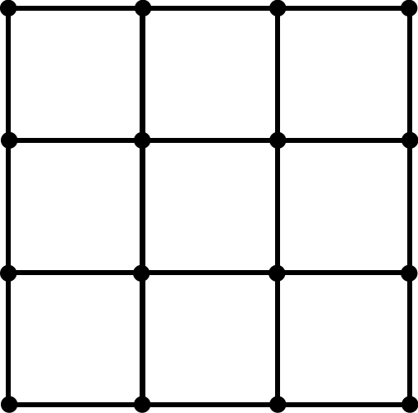
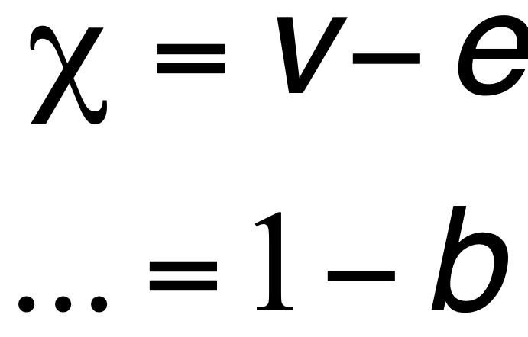
Notes:
Here we see the graph corresponding to the street network: we can count its vertices and edges (nodes and links) and the difference between them (it is known) is the Euler characteristic. Nice no? The idea is that all cities with the same number of blocks are deformations of this shape, but all belong to the same topological class ! There is a universal topology of cities, with they “size” indexed by b their block number.

Slide 14
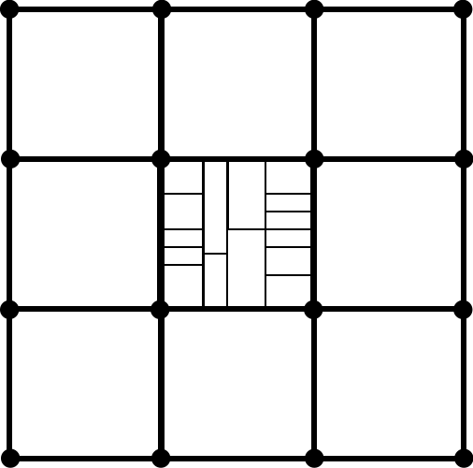

Slide 15

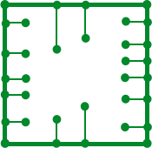

Slide 17


Slide 18
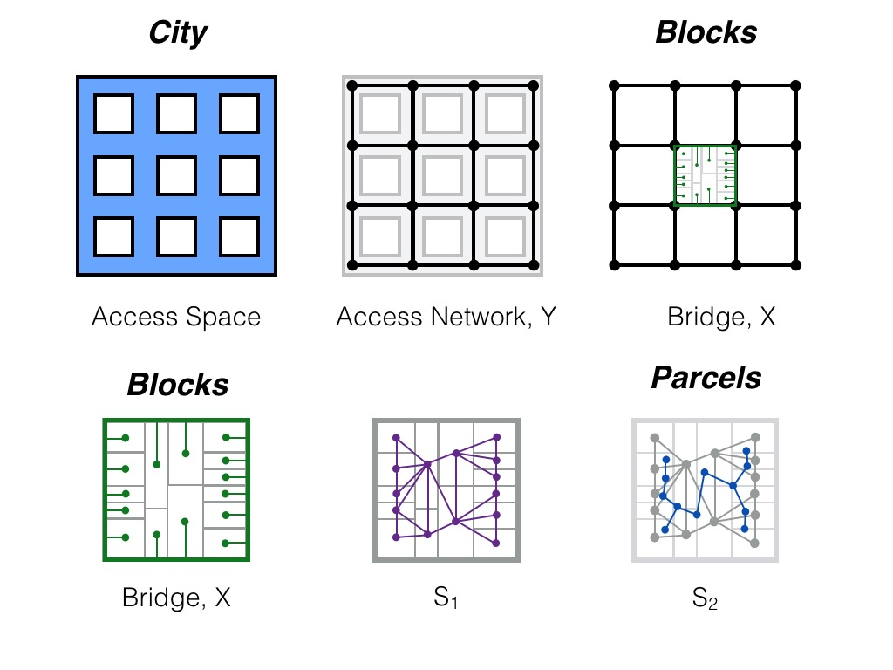
Notes:
OK, so we see the steps of this abstraction, from the actual city to the street network graph, from which we can measure its universal topology. In addition —pay attention, this is important for slums— each building has a terminal bridge (an access) to the street network. This is how you walk in and out of buildings onto the street and how water, sanitation and power get in and out as well. These terminal connection do not change the topology but are the “leaves” of the graph to which each place must be connected to get its basic functions. This happens again regardless of geometry, it is a relational property that can take many shapes.

Slide 19
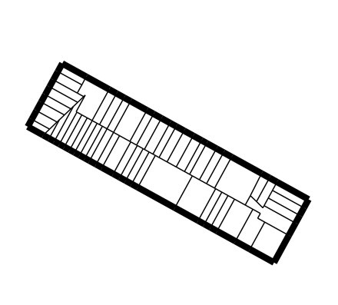
Notes:
OK, we can look at these properties for any city block in any city: this is a city block from Hell’s Kitchen, in NYC (note how regular it is as it is part of a street grid). Note that every buildings (land parcel in the block) has a street access (none is interior).

Slide 20
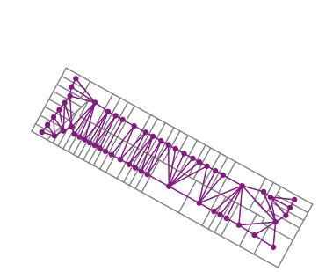
Notes:
We can characterize this property by building a graph of relationships between parcels, wager each one is a node and has an edge to its physical adjacent neighbors. Here shown in purple.

Slide 21
Notes:
We can then build a graph of the first graph (this is called a dual), shown in blue. It turns out that if this blue graph is a tree (no loops) all the original parcels have street access. We then have an algorithm that we can take for a spin and make sure that all buildings in every city have direct street access and can get water, sanitation and so on. Note that we did not have to say anything about the shape of the city, its history, its materials or culture…

Slide 22
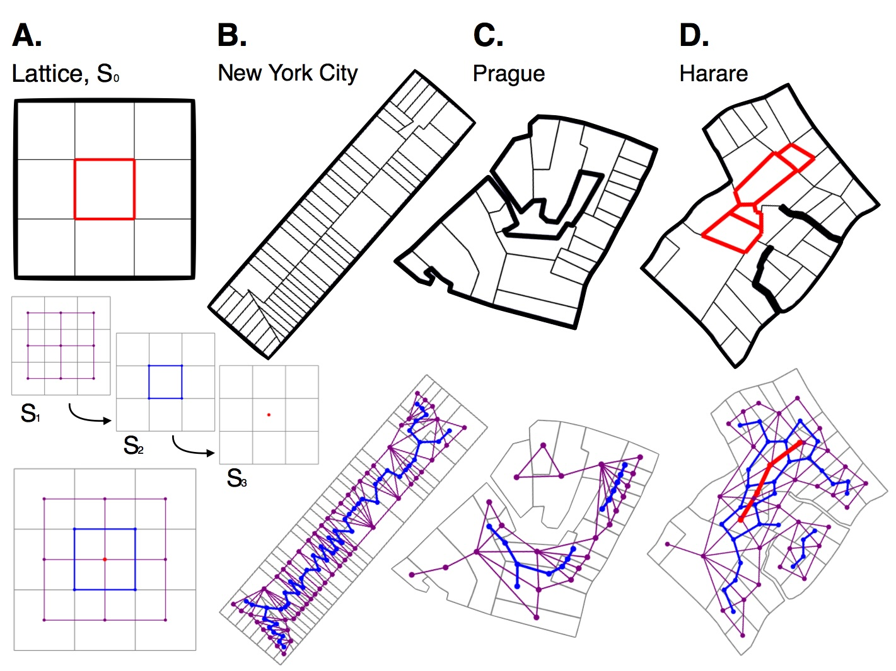
Notes:
Ok : here are a few more blocks: A is just an example, but it shows that the first dual graph in blue is not a tree if there are internal parcels. No internal parcels in Hell’s Kitchen, and none in a curvy city like Prague. But look at Harare: the blocks in red are internal: they are all one layer away from the street, this can be measured by seeing that the next dual (in red) is a tree. And so on.

Slide 23
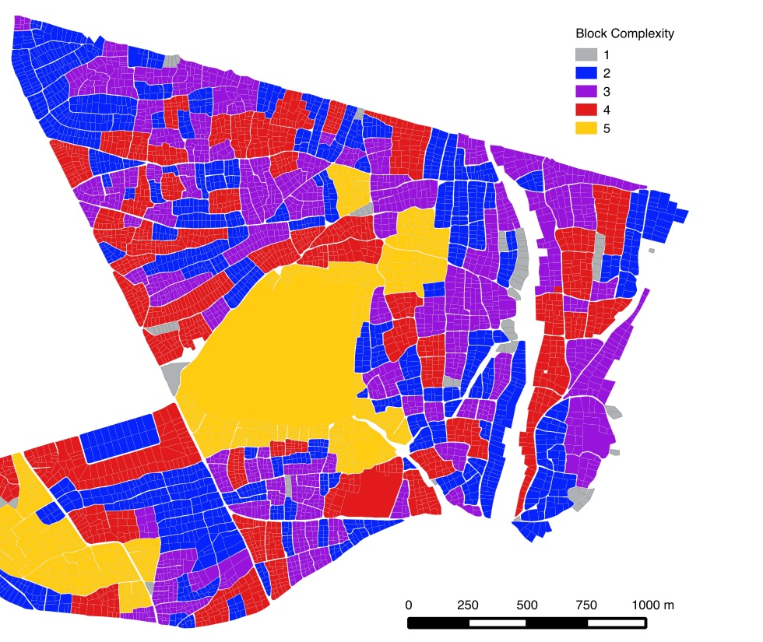
Notes:
Let’s take the algorithm further in the wild and look at many blocks in Harare (you can find the one before if you look). We can now characterize each block by the number of layers of lack of access to streets: it turns out that these are indicators of lack of services and in this sense of blocks that are informal and hard to service. The deeper the layers the worse the situation: this is why we call it the “block complexity”.

Slide 24
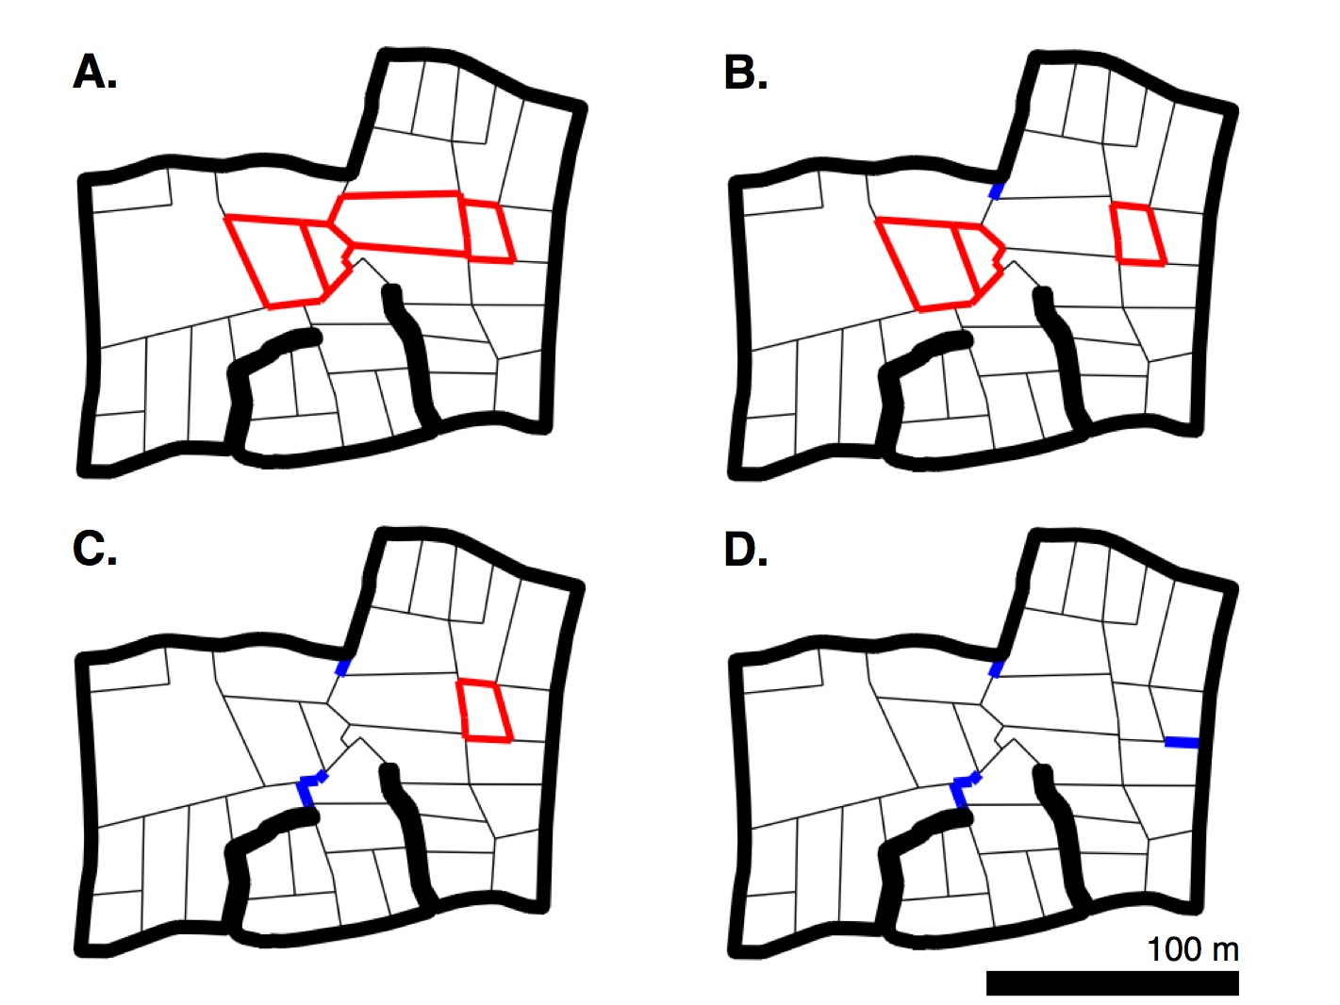
Notes:
What to do? A solution is simply to extend the street network into the block so that accesses to internal parcels are created and services and addresses can be delivered. Sometimes this can be done by extending dead ends and driveways as shown…

Slide 25
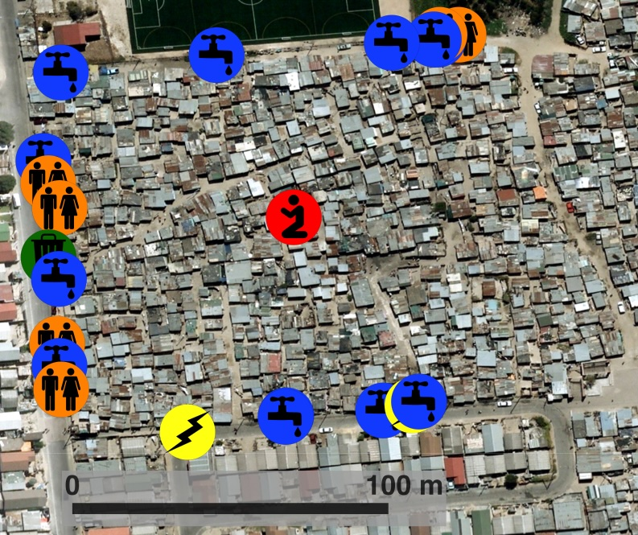
Notes:
But it gets hard in more complex blocks. This is outside Cape Town, South Africa, and shows that municipal services are where the streets end, even though the community center/ church /bar is in the center. This is a nice illustration of the problem…

Slide 26
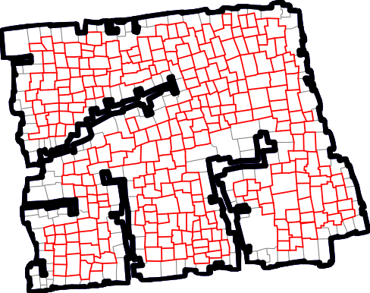
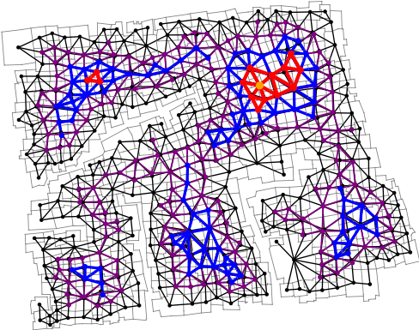
Notes:
In this block there are 433 parcels, 258 without direct road access. 9 levels of nested duals, (I only plotted the odd ones). We can use the graphs to tell us which they are.

Slide 27
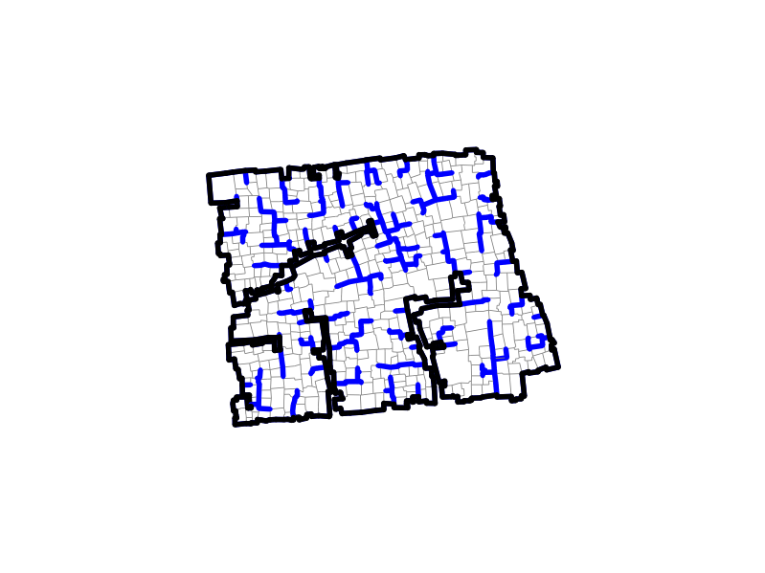
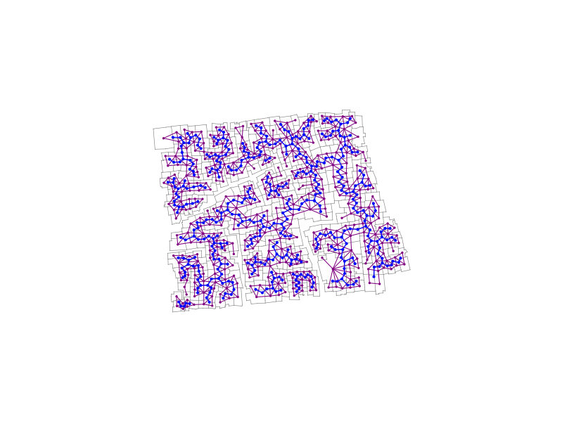
Notes:
We can also then grow streets into the neighborhood that provide accesses. This is a minimal solution, and is not always the desired one, but give us a sense of the minimal network that could do the job … in blue above.

Slide 28
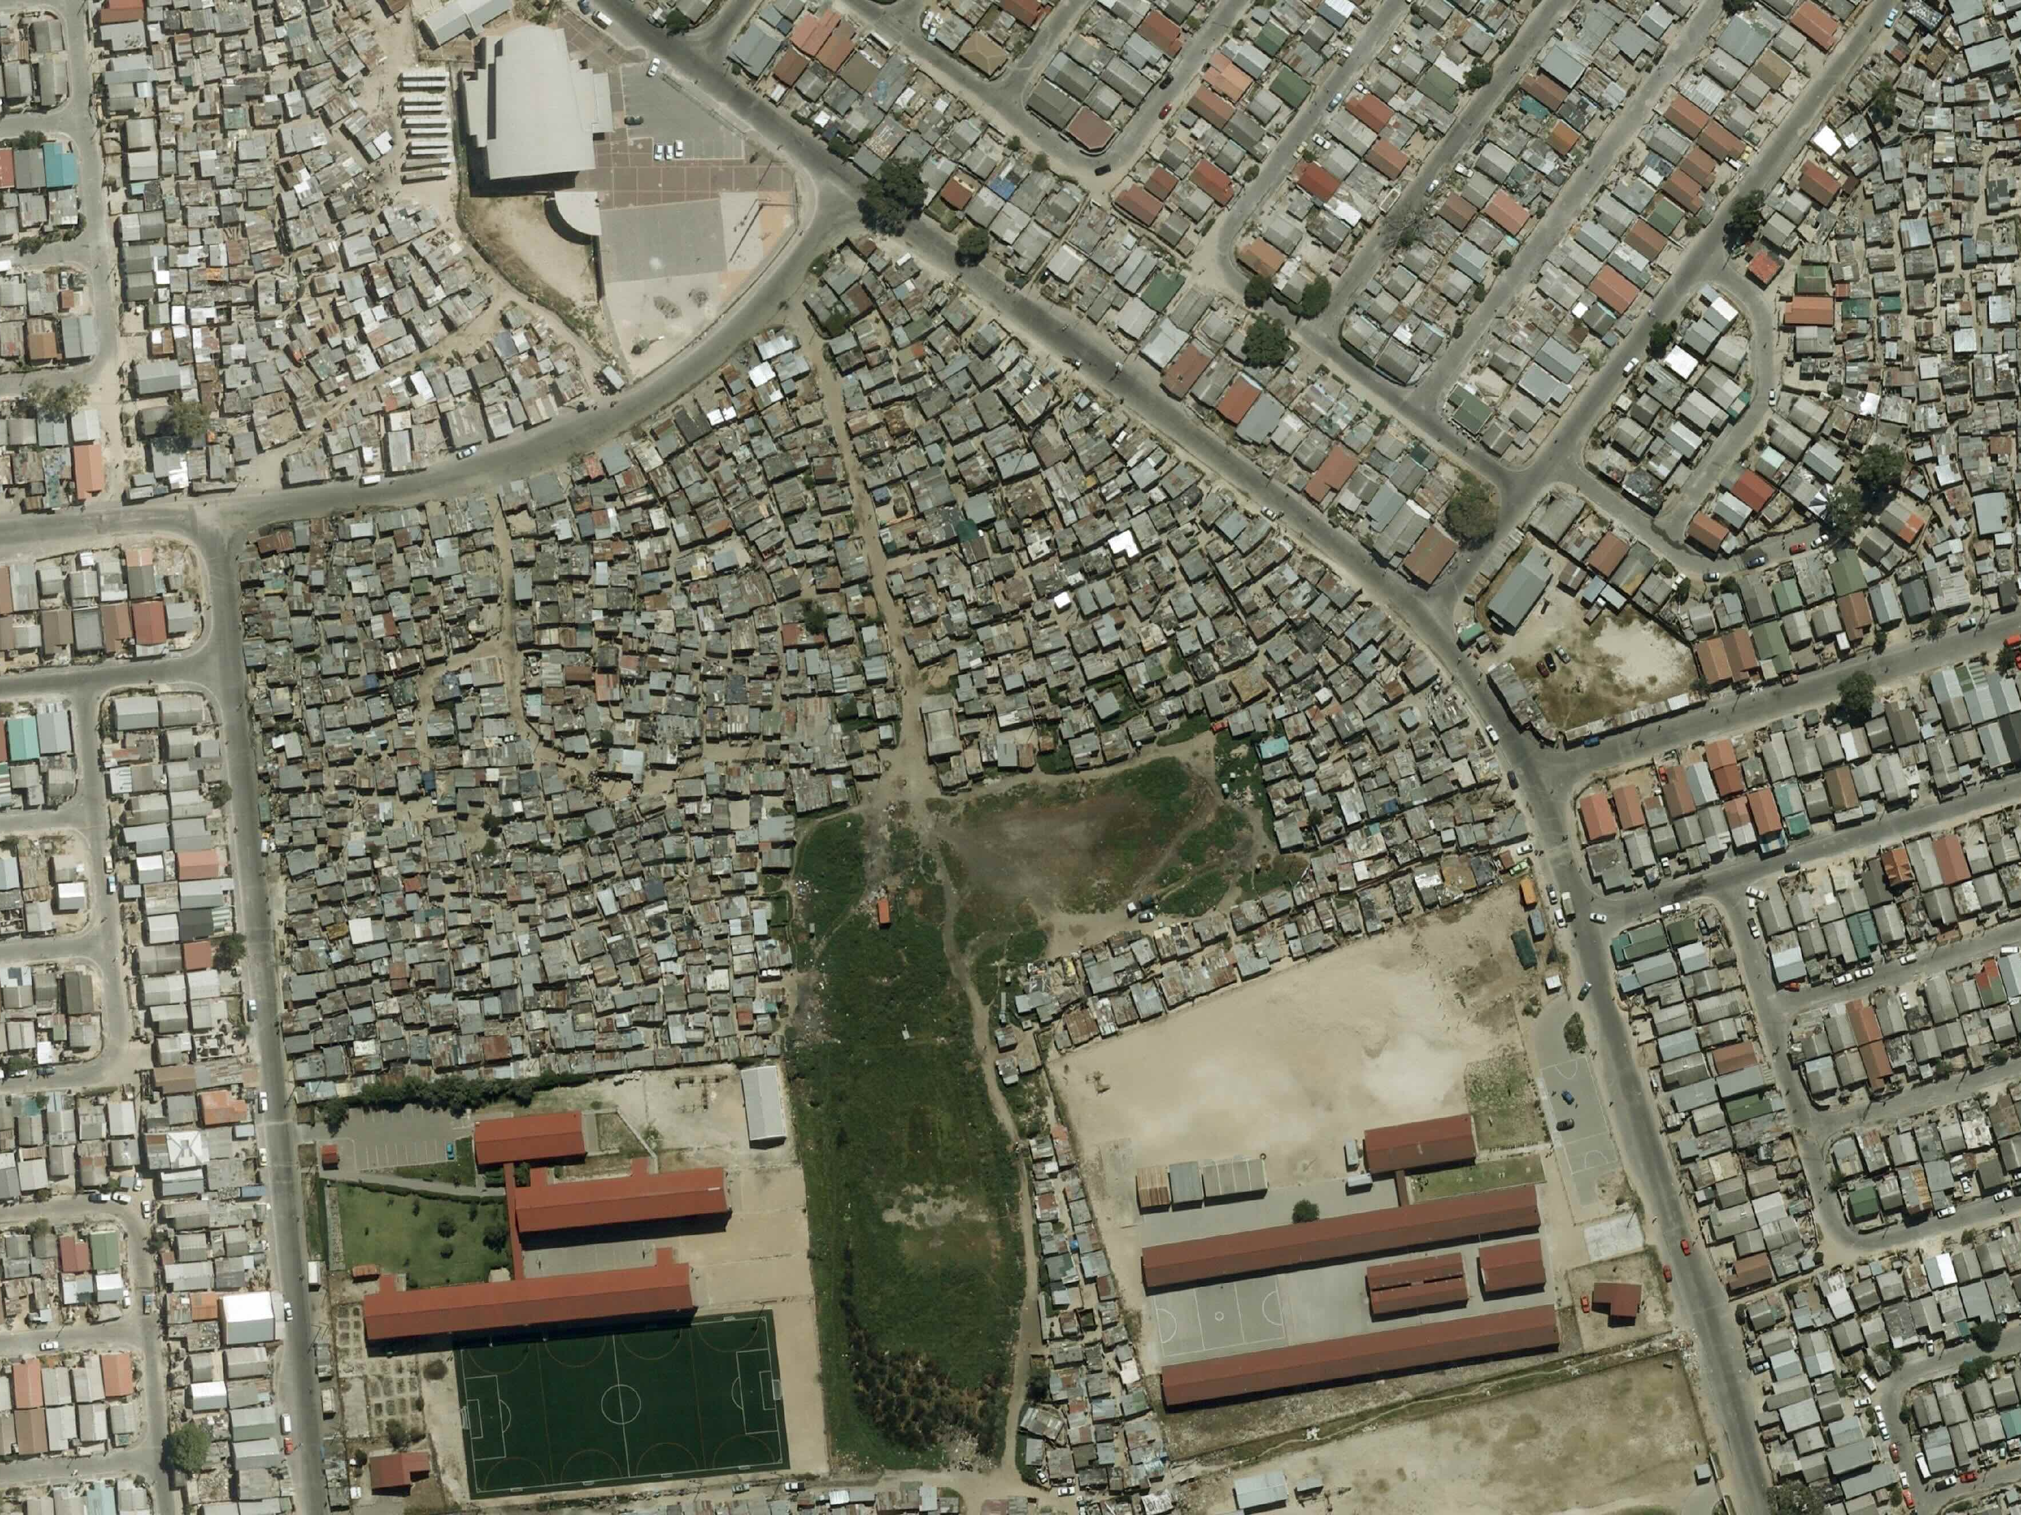
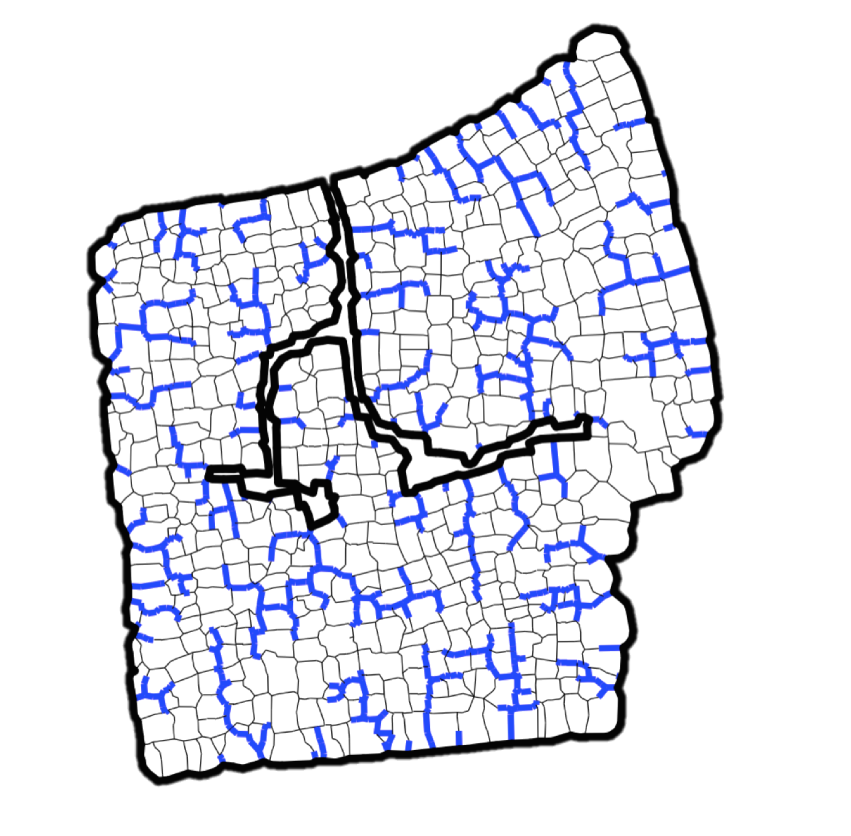
Notes:
Here is another example. Often these paths are build and expanded informally by residents. Many informal settlements have dead ends because these are the solutions that take the least space.

Slide 29
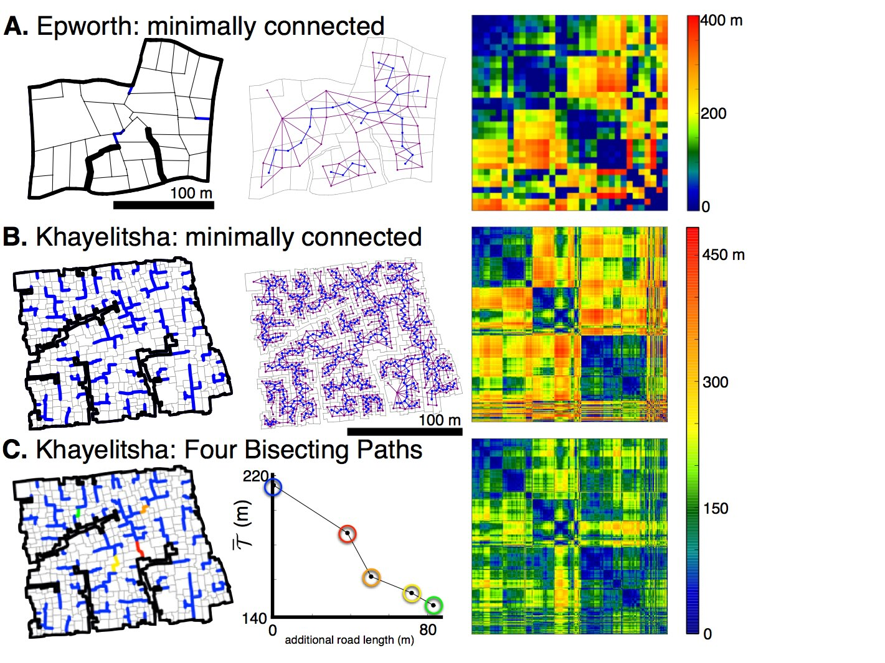
Notes:
And there are places that once connected to create new blocks (in colors) can dramatically shorten trips between places. See the change in the distance matrix.

Slide 30
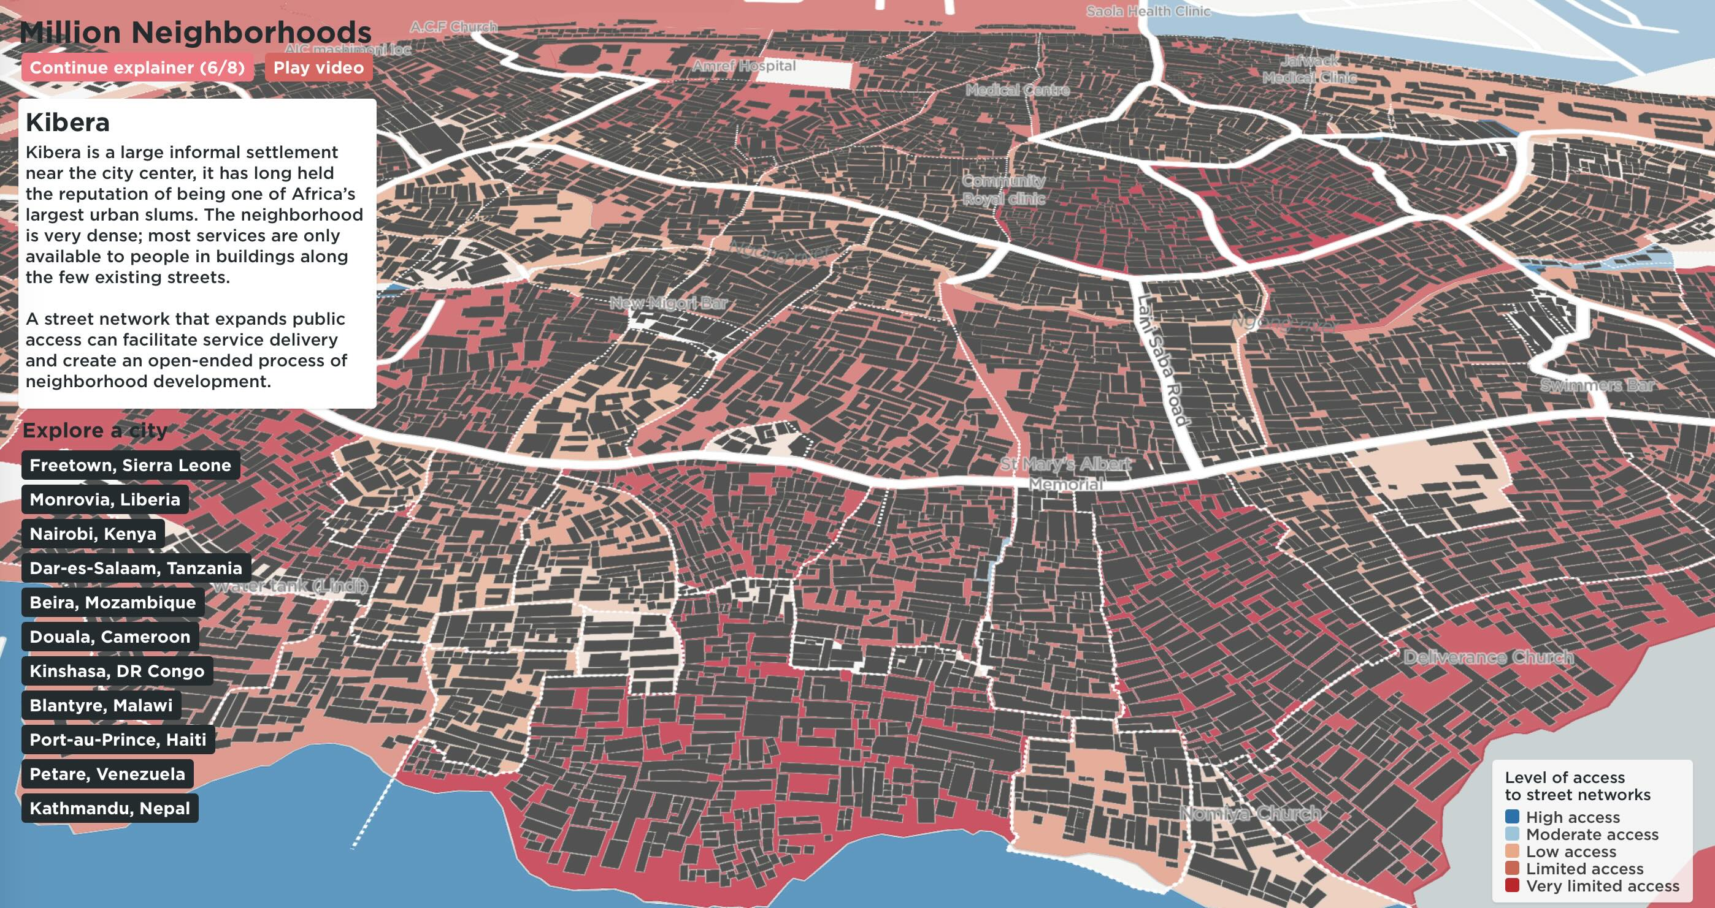
Humanitarian OpenStreetMap
millionneighborhoods.org
Notes:
We can take this to scale, here in Kibera, Nairobi.

Slide 31
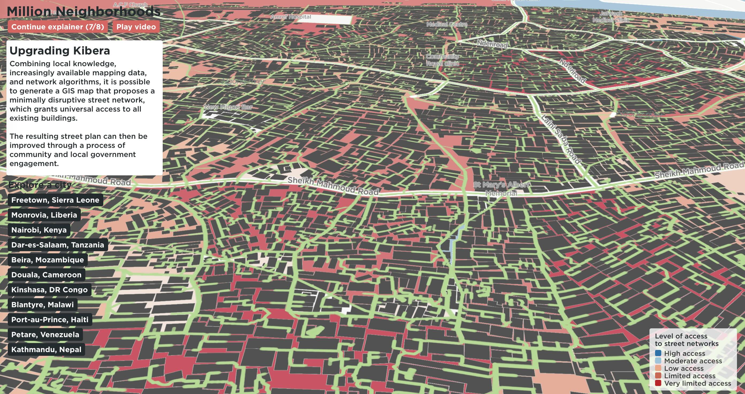
millionneighborhoods.org
requires >140 km of new streets in Kibera
+opportunities for public spaces, cadastral maps, addresses, basic services
Notes:
Which would need (at a minimum) 140 km of additional accesses to connect every building.

Slide 32
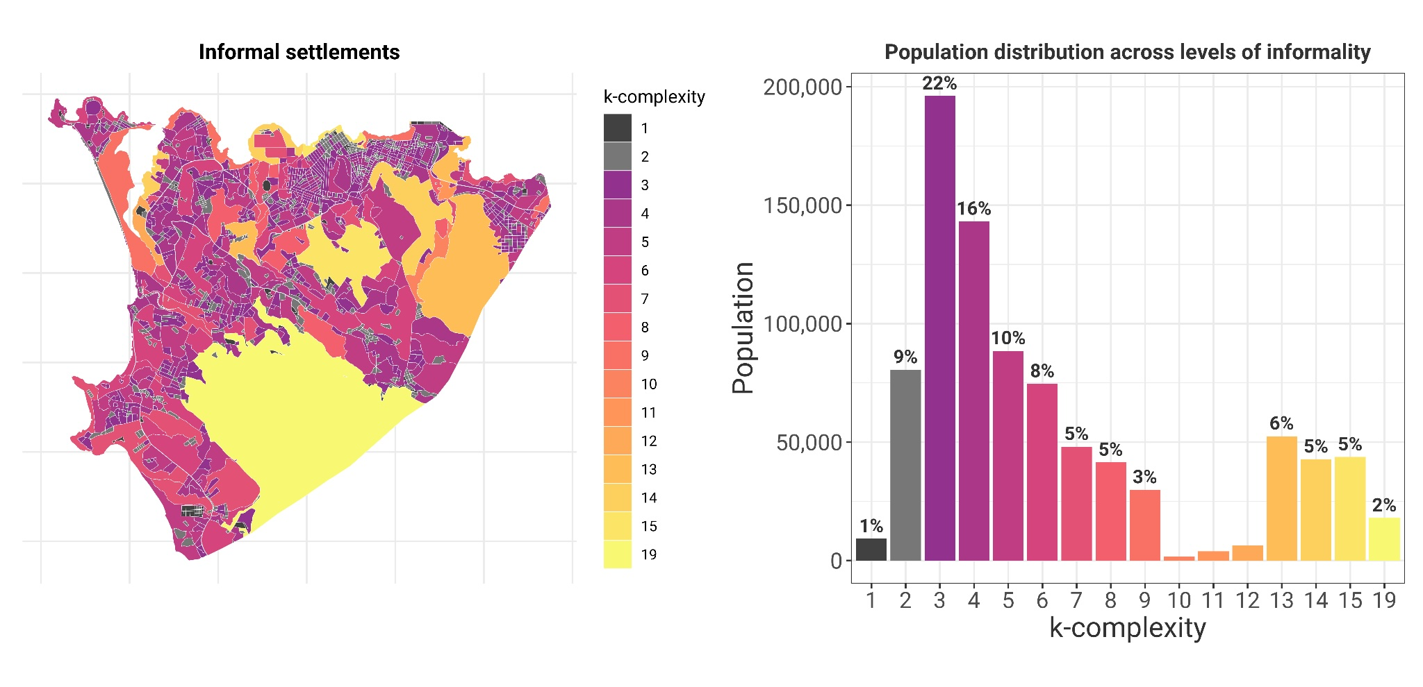

new data 2022
Spectrum of informality
requires
major
interventions
Total Population: 880,537
requires
minor extensions
of streets+services
© University of Chicago
Notes:
Recent work takes this to scale everywhere - here is Freetown in Sierra Leone : we see than many neighborhoods need additional accesses, but only a few have large deficits characterized by large block complexity. There are often peripheral or periurban,

Slide 33
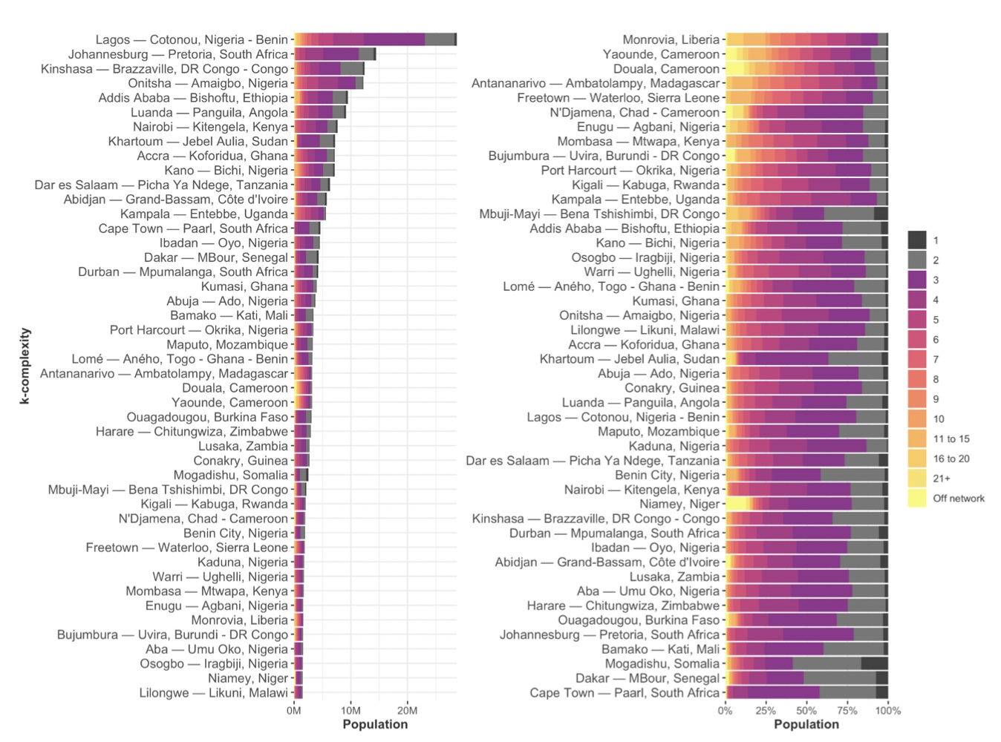

Notes:
And then we can characterize every city by the distribution of the complexity of their blocks, here for Sub-Saharan Africa.

Slide 34
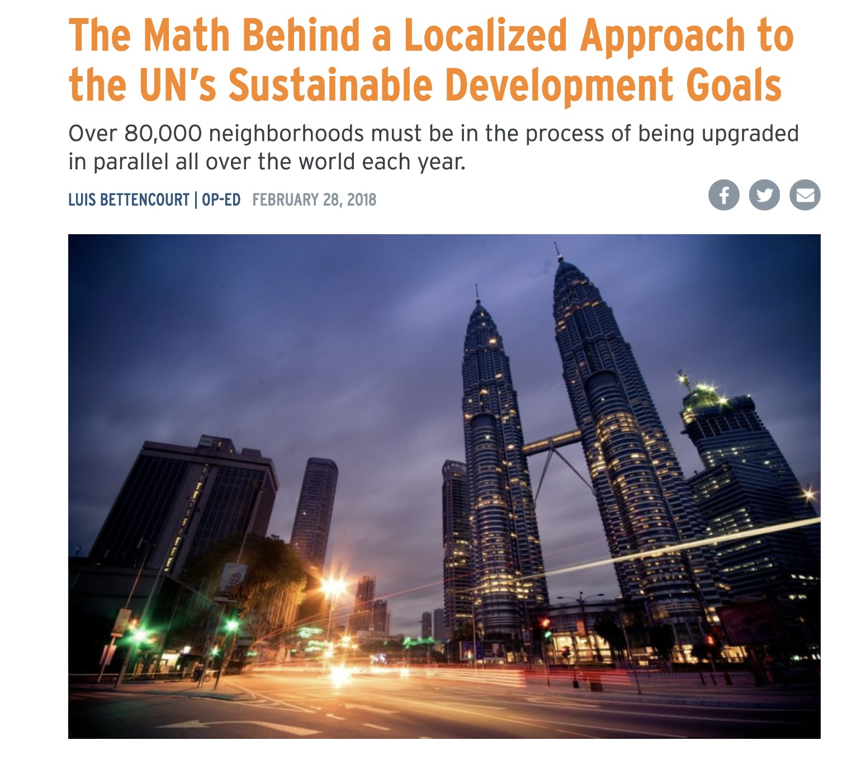
https://nextcity.org/urbanist-news/the-math-behind-a-localized-approach-to-the-u.n.s-sustainable-development-g
Notes:
You can see the global math on this type of problem in this blog piece. What would it take to service and upgrade every block (but don’t forget that we can now actually measure each specific block and do better than this general estimate).

